Slide 1
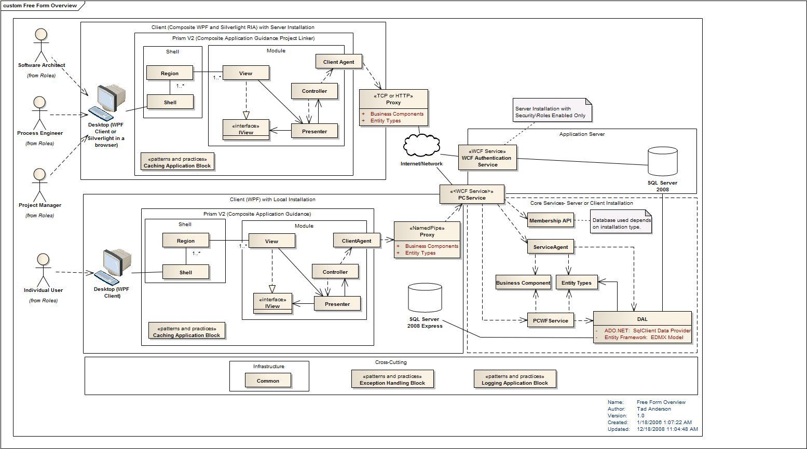



Microservice Architectures
And why Owin & Katana are going to be game changers
Peter “Shawty” Shaw
Notes:
Welcome to DDD Scotland, I hope you all had a good lunch and are hopefully not so full that you’ll fall asleep in this session :-)
As the title says where going to be talking about microservice architectures in this session, first of all however (CLICK)

Slide 2
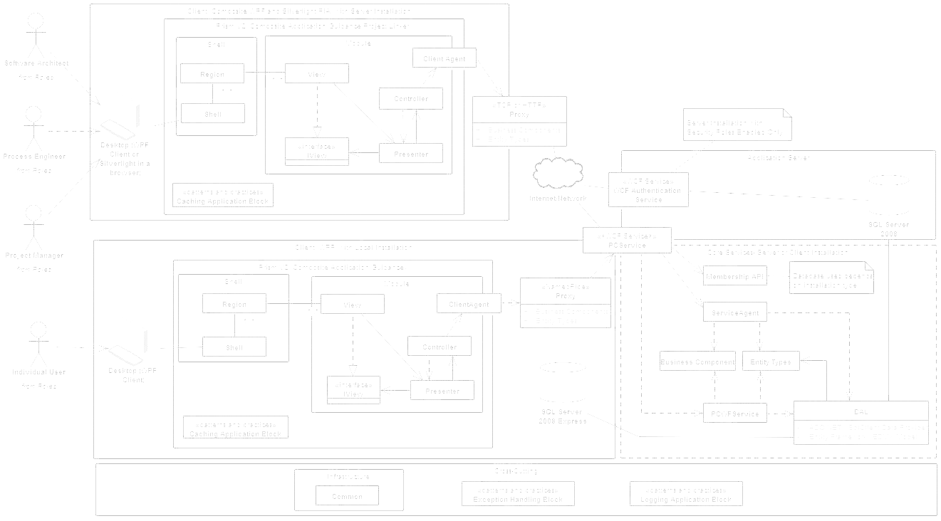
Who Am I
I’m the UK & Europe group manager for the Linked.NET Users group (Lidnug) a global .NET user group based on the Linked-In platform.
I’m a Pluralsight Author and one of the main Authors in the Syncfusion Succinctly Series of free EBooks
I’ve been doing I.T & Computing in one form or another since the early 1980’s and I pride myself on being one of the UK’s original back bedroom developers.
I now own & run Digital Solutions UK, offering consultancy & other I.T related services in the North East of England.

Slide 3
Who Am I (How to contact me)
You can find me on twitter as
@Shawty_ds
You can find me on Linked-In
https://www.linkedin.com/in/petershaw08
You can email me
Shawty.d.ds@googlemail.com

Slide 4
Session Agenda

Slide 5
Session Agenda
Define what a Microservice Architecture is
Benefits
Drawbacks
Explain why Owin & Katana have an important role to play
Lightweight Services
Platform Agnostic
Practical/Technical demonstration
Working Microservice Setup under IIS7
Tour of some Owin/Katana services & code
Notes:
Since we only have 60 minutes, this session won’t be particularly heavy on details.
As much as I’d love for it to be a deep dive I simply won’t have time to cover everything, we’ll use the first 30 minutes or so taking a fairly high level look at what the pattern represents and some of it’s benefits and drawbacks.
We’ll define what it’s attributes are, and look at some of the theoretical points surrounding it.
We’ll then move on to a quick overview of what Owin & Katana is, and how it fit’s into the microservices architectural pattern, and more importantly why you seriously need to be looking at using it.
Finally we’ll take a look at a ready made Visual Studio and IIS7 Solution that implements the pattern in a very basic form, where I’ll talk you through some of the code and techniques used to make it worth while.
Since I don’t have much time, if we could leave any Questions until the end of the session, and time permitting I’ll do my best to answer as many as I can.

Slide 6
What is a Microservice
Architecture?

Slide 7
What is a Microservice Architecture
It’s an architectural project design pattern
It’s a set of guidelines on which to base deployment choices
It’s already supported by EVERY server setup on the planet
It’s been around for a long time (or at least the concept has)
Notes:
Microservice architectures are a project level architectural design pattern, they are not as some might try to have you believe a software design pattern. Martin Fowler on his blog makes this mistake and tries to define “Microservice” as a modular concept at a single application level. While you can apply it in this manner (as we’ll see in just a moment) the concept is actually far more reaching than a singular application.
From a guideline point of view the Microservice pattern helps you decide what hardware/software you need to deploy and how, unlike the more traditional model where you map out the software architecture, build the initial model then performance test it to see what’s needed to run it. With the Microservice pattern you also get a lot of flexability in those guidelines.
From a support perspective you don’t need anything special to deploy the Microservice Architecture pattern. Every web server based platform currently available has everything needed out of the box to make it work, and in the few cases where it’s not available out of the box it’s generally easy enough to add it after the fact.
It might surprise many that the pattern has been around for a very long time, and there’s a very high chance that you’ve used it without realizing. As a pattern, it’s concept has been hijacked and moulded into something that many of us already have first hand experience with and that’s the general SOA based pattern.

Slide 8
What is a Microservice Architecture
It’s the very opposite of the general purpose monolithic architectures we seem to use today
It makes scaling easier and more importantly, less costly
It’s separation of concerns over and above software level
It’s NOT platform specific
Notes:
Most of us developing software in .NET today will most likely be using ASP.NET MVC, MVC is a perfect example of a monolithic architecture. MVC can be deployed in a Microservice deployment, but only as part of a greater deployment strategy that would see it being used as part of a larger network of services and user interfaces.
One thing that will please most folks in here about the pattern however is it’s ability to changed dynamically with very little impact. Because of this scaling horizontally is also very easy AND (this ones for the business minded folks in here) costs on average, much less than scaling out an entire monilithic code base.
Because it’s a flexible architecture, EVRYTHING is layered. For those of you who practice n-tier in a monolithic MVC application, you can immediately go out and start using Microservices, simply by splitting your layers up into discrete layered projects that communicate using a loosely coupled, disjointed medium.
Finally, it’s not something that’s platform specific, if you have the ability to write web services on a platform or in a given language then that ability can be used in a Microservice deployment. Even a linux shell script, sitting listening on a port via the command line Net-Cat tool can be used as part of a Microservice deployment.

Slide 9

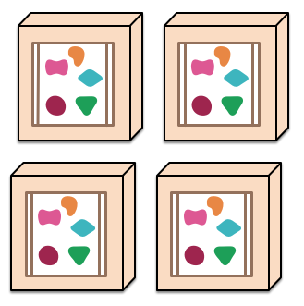
What does a Microservice Architecture
Look like?
First let’s see a monolithic architecture for comparison
Notes:
So what does a Microservice Deployment look like. Before we answer that question let’s take a look at a typical monolithic architecture for comparison.
(Credit where it’s due, the diagrams I’m using have been borrowed from martin fowlers blog at martinfowler.com, if your interested in software architecture in anyway esp under .NET you should pay it a visit)
In a typical monolithic architecture we have a single application, that usually has all the parts required for our application to run, if you imagine our application is the smaller entity here at the top, when we deploy, we typically push that entire single unit onto our servers, as a single entity, giving us one copy of the application per server.
In the diagram above, we have 4 copies on 4 servers, which for many of you will most likely mean 4 applications deployed on 4 Microsoft Azure instances.
If your app is large then that deployment may take time, worse still if you have to add or update any functionality in the application, you have to take the entire app offline to update it.
This might not be a problem if you have multiple geographic deployments because you can easily take an instance down, replace it, then spin it back up, repeating the process for each of the other instances, but for a single app on a single server, this could mean downtime.
And what about scaling up, to meet demand? (CLICK) our 4 servers, and all the heavy bandwidth, I/O and bills that go with them, when our 4 servers suddenly become 8 or more.

Slide 10
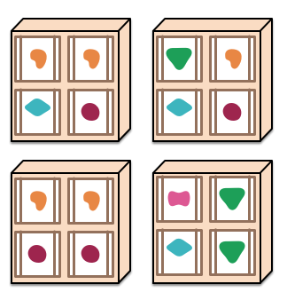
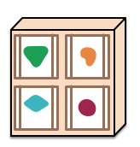
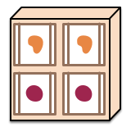
What does a Microservice Architecture
Look like?
Notes:
In a Microservice Architecture each module of functionality is different.
You may have a Module that handles accounting, one that handles sales and another that handles a catalogue.
Because each module/service is an independent entity, when we deploy our services out to our servers, we deploy only what we need to initially meet demand.
In the diagram on screen you can see that the deployments on each of the 4 servers are made up of singular pieces each with a specific function.
When we scale (CLICK) we only have to scale the individual smaller parts needed to fill that demand, as opposed to a large monolithic entity ,where only a small fraction of it may get used.
If we are asked to add extra functionality (CLICK) that’s just as easy too.

Slide 11
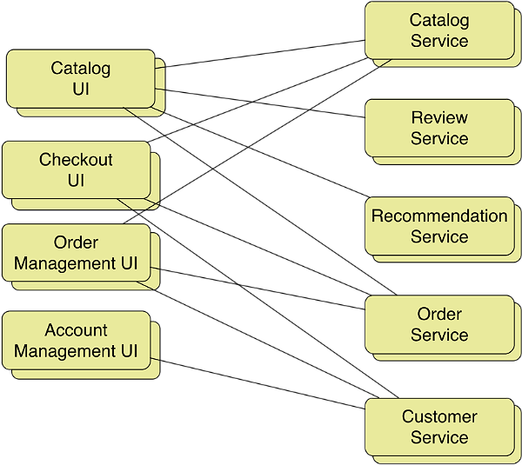
What does a Microservice Architecture
Look like?
/Account
/Account/Service
Notes:
In practice, it looks very much like this.
Typically you have one app platform that acts as a master and holds most of the UI, then you have some kind of URL re-writing mechanism that “re-directs” the leaf nodes in your application to the appropriate services.
(CLICK)
For example, the account management UI might live at ‘/Account’
(CLICK)
But the customer service might live at ‘/Account/Service’
To the end user, everything appears to be seamless, and from the outside actually looks like a single monolithic application with everything served off the same URL, but under the hood it’s an amazingly flexible and dynamic set up.

Slide 12
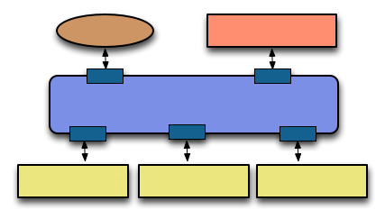
How do the modules/services communicate?
There are currently 2 common schools of thought.
External Client
Website Client
Enterprise Service Bus (e.g.: Redis or RabbitMQ)
Service Module
Service Module
Service Module
The Enterprise Service Bus Way
Notes:
Communication between the various modules is often the most hotly debated topic when designing a Microservice Deployment, and there are two main schools of thought here.
Many people have a preference for the Enterprise Service Bus way of doing things, where you have a central communications bus.
Messages are posted to this bus, and each of the services in the solution watch for messages they understand.
This is a good solid communication method, but it does have the disadvantage of ALWAYS requiring one single point of contact, and as most of us likely know where there’s one point of contact for everything, there’s one point of failure for everything also.

Slide 13
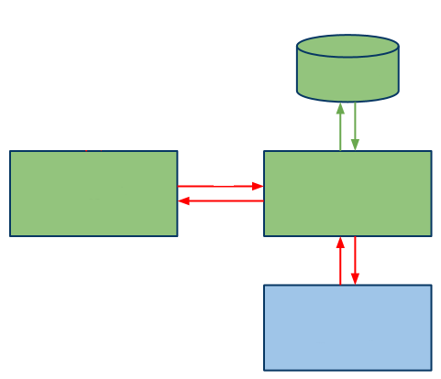
How do the modules/services communicate?
There are currently 2 common schools of thought.
Database
Native
JSON
Website Client
Rest API
JSON
External Service
The Restful/HTTP way
Notes:
The second generally accepted way is via a restful based JSON interface.
Where a client typically talks directly to a given service, usually using JSON. This service then accepts the JSON data, process it in some way either by making further JSON calls to an external service, or by some kind of native binding to a database.
This for many seems to be the more accepted way, especially when deployed to applications which change frequently or have high scaling needs, as it means that individual parts can easily be swapped out as needed without having to remove dependencies also.
Some deployments even use both methods, with a large group of back end services sharing data via an ESB, but with the UI layers communicating to a common facade which then connects to these services via the ESB solution.

Slide 14
Benefits of a Microservice Architecture
Loosely coupled application teams rather than divided teams with specific technical silos.
Think of your own team, do you actually involve your DBA’s and maintenance guys in your development cycle?
Applications have a modular structure
It’s all about flexibility and changing business needs
Things are pluggable
If you have ANY experience with Linux/Unix then think about ‘pipes’ and chaining commands together
Notes:
Some of the many benefits that a Microservice deployment will bring you are, Loosely coupled teams.
When was the last time you maintained your application? When was the last time you involved your DBA’s, UI Designers, Managers, Domain Specialists and other key players on a project in your development efforts?
If your anything like most teams, I can guarantee the answer is pretty much NEVER. If you think about it though, ALL of these people have key bits of information that are crucial to your applications ongoing health, with “application” groups no more do you have the “Throw it over the wall for the next team” syndrome
Because your applications are modular, you can now have specialist teams that look after the “Accounts Module” or the “Shopping Service”, if the business needs a “Widget Manager” adding, they can easily build a team that has experience building “Widget Managers”, this team can develop the application in isolation quite easily then simply “connect” it to the live site when it’s fully tested and working, without causing any problems to the already live application.
Likewise, old modules that are no longer relevant can just as easily be pruned and removed.
Finally things are “Pluggable” and “Chainable”, which means you can easily connect 2 or more services together to act as a processing pipeline. You might for example have a service that retrieves a list of “Do Dah’s” from the product catalogue, that list may be requested by a customer preferences service which has knowledge of a customers favourite colours and can then filter the list to only include the ones the customer will most likely buy.
If you have any experience with linux or unix systems or general console based environments then you’ll understand straight away the process I’m trying to describe here.

Slide 15
Drawbacks of a Microservice Architecture
Potentially higher maintenance cost
Because things are more spread out, possibly over different platforms maintenance is going to be fraught with more problems and potential costs
Data Islands
Data can easily get disjointed, simply because of the unique nature of the architecture.
Monitoring
For a successful service deployment, monitoring is ESSENTIAL, dashboards monitoring every aspect of every service must be in place to notify you of every metric.
Notes:
Maintenance costs are going to be higher, especially at the IT-Pro and server admin end of the scale. Because you have so many separate moving parts, you need a reliable service team that understands the overall big picture.
These days this maintenance burden is made much easier by the growing DevOps movement, but with such a spread out surface area, there are still going to be gotchas and surprises waiting to bite. You might also need to diversify your staff to work on different platforms and environments which they may not be knowledgeable about.
Because by it’s nature, independent modules are in essence disconnected from the mother ship, then you also have a problem of potential data islands forming. You might even find that an application can be introduced, performing a service that already exists, or has very similar data that exists elsewhere.
To avoid these issues, you need a good solid management team that manages and facilitates communication between the different application teams to lessen the impact of things like this.
Finally monitoring is absolutely essential, there simply is no other way to put this.
MONITOR ALL THE THINGS!!
If your not monitoring the smallest of nodes in the solution, then you run the risk of loosing a jig-saw piece when you least expect it, just like any machine you need to look after all the moving parts as a whole collection, not just the parts your interested in.

Slide 16
Why Owin & Katana

Slide 17
Why Owin & Katana
In A Nut Shell
Because it’s an ideal way to create small, nimble and flexible services on ANY platform
Middleware
Cutting out the bloated overhead of things like “System.Web” and “System.Web.Mvc” and opting for a more streamlined middleware just works. Why do you things things like NodeJS are so successful?
Cross Platform
Owin is an “Open” standard, which means it’s available in the public domain for ANY platform provider to implement

Slide 18
Why Owin & Katana
It’s already established in .NET and Linux
Katana is Microsoft’s implementation of the Owin standard. It’s also already available on the Linux/Unix platform as an Apache 2 module called “NoWin”
Many toolkits already support it
Web-API, NancyFX, OpenStack and many more already understand the interface semantics so can already work ahead of the .NET vNext strategy
You DON’T need a web server
Just as NodeJS can spin up a service endpoint without a web server, so can Owin and it’s related family

Slide 19
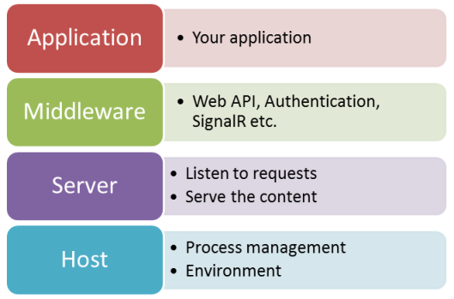
Owin is Modular
Which is great for Modular Architectures

Slide 20
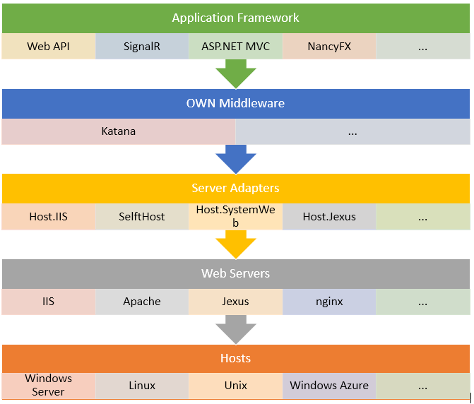
Owin is Layered
Which is great for a layer based disconnected approach

Slide 21
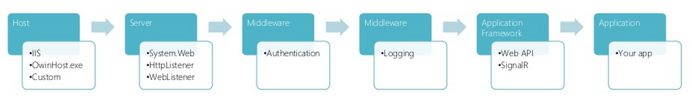
Owin is a Pipeline
Which is great for chainable/pluggable services

Slide 22
Why Owin & Katana
Owin makes for a great platform to run services on
The choices you have extend to many different platforms and architectures from .NET to Apple
.NET is NOW Open source
Because .NET is now open source, the .NET ecosystem can be ported to anything that can build it, splitting up ASP.NET and the monolith that is System.Web into Owin pipeline modules is now easy
One Common Environment, a Million different possibilities
.NET truly is entering a new era of write once, run anywhere, i can now even run a full .NET stack on my Raspberry PI!

Slide 23
Demo Time

